Slide 1
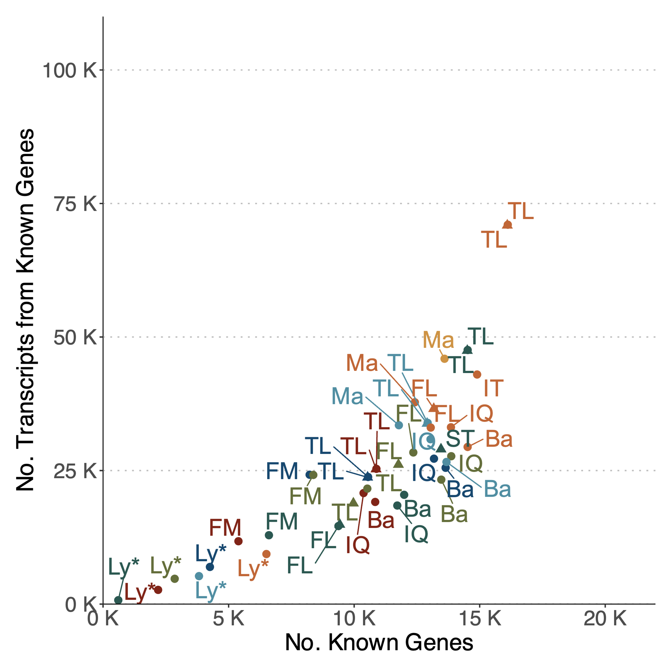
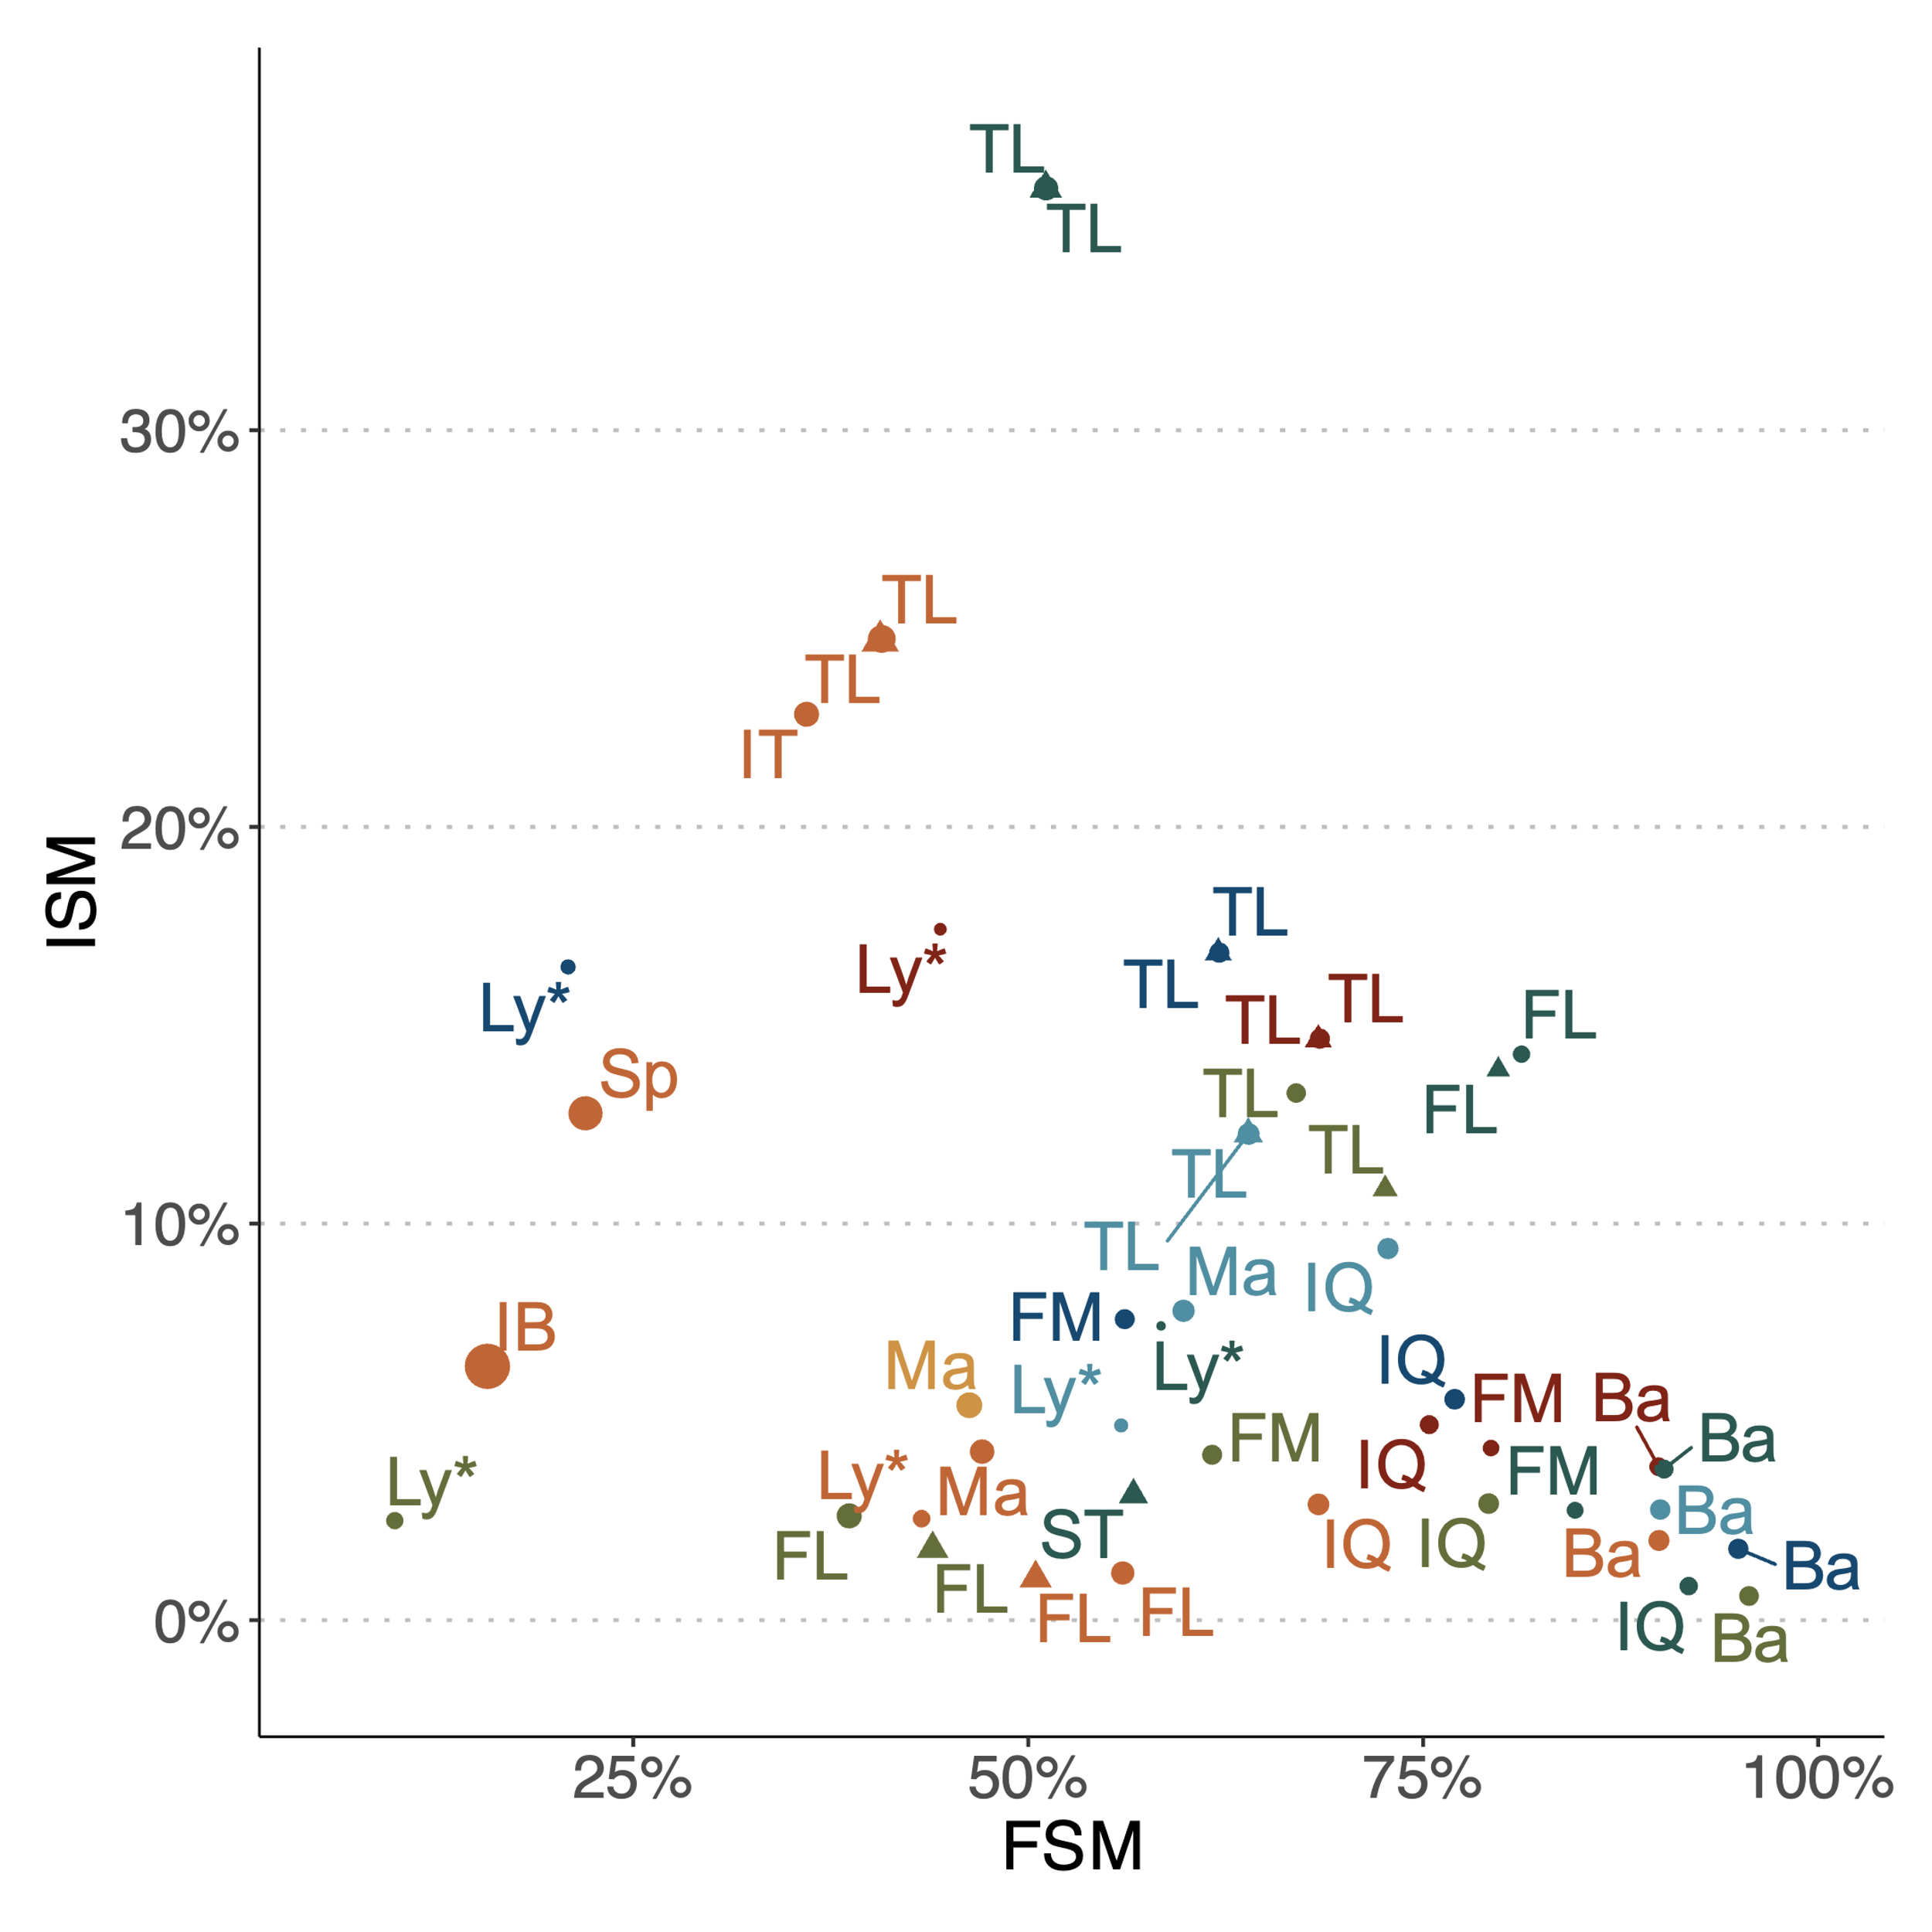
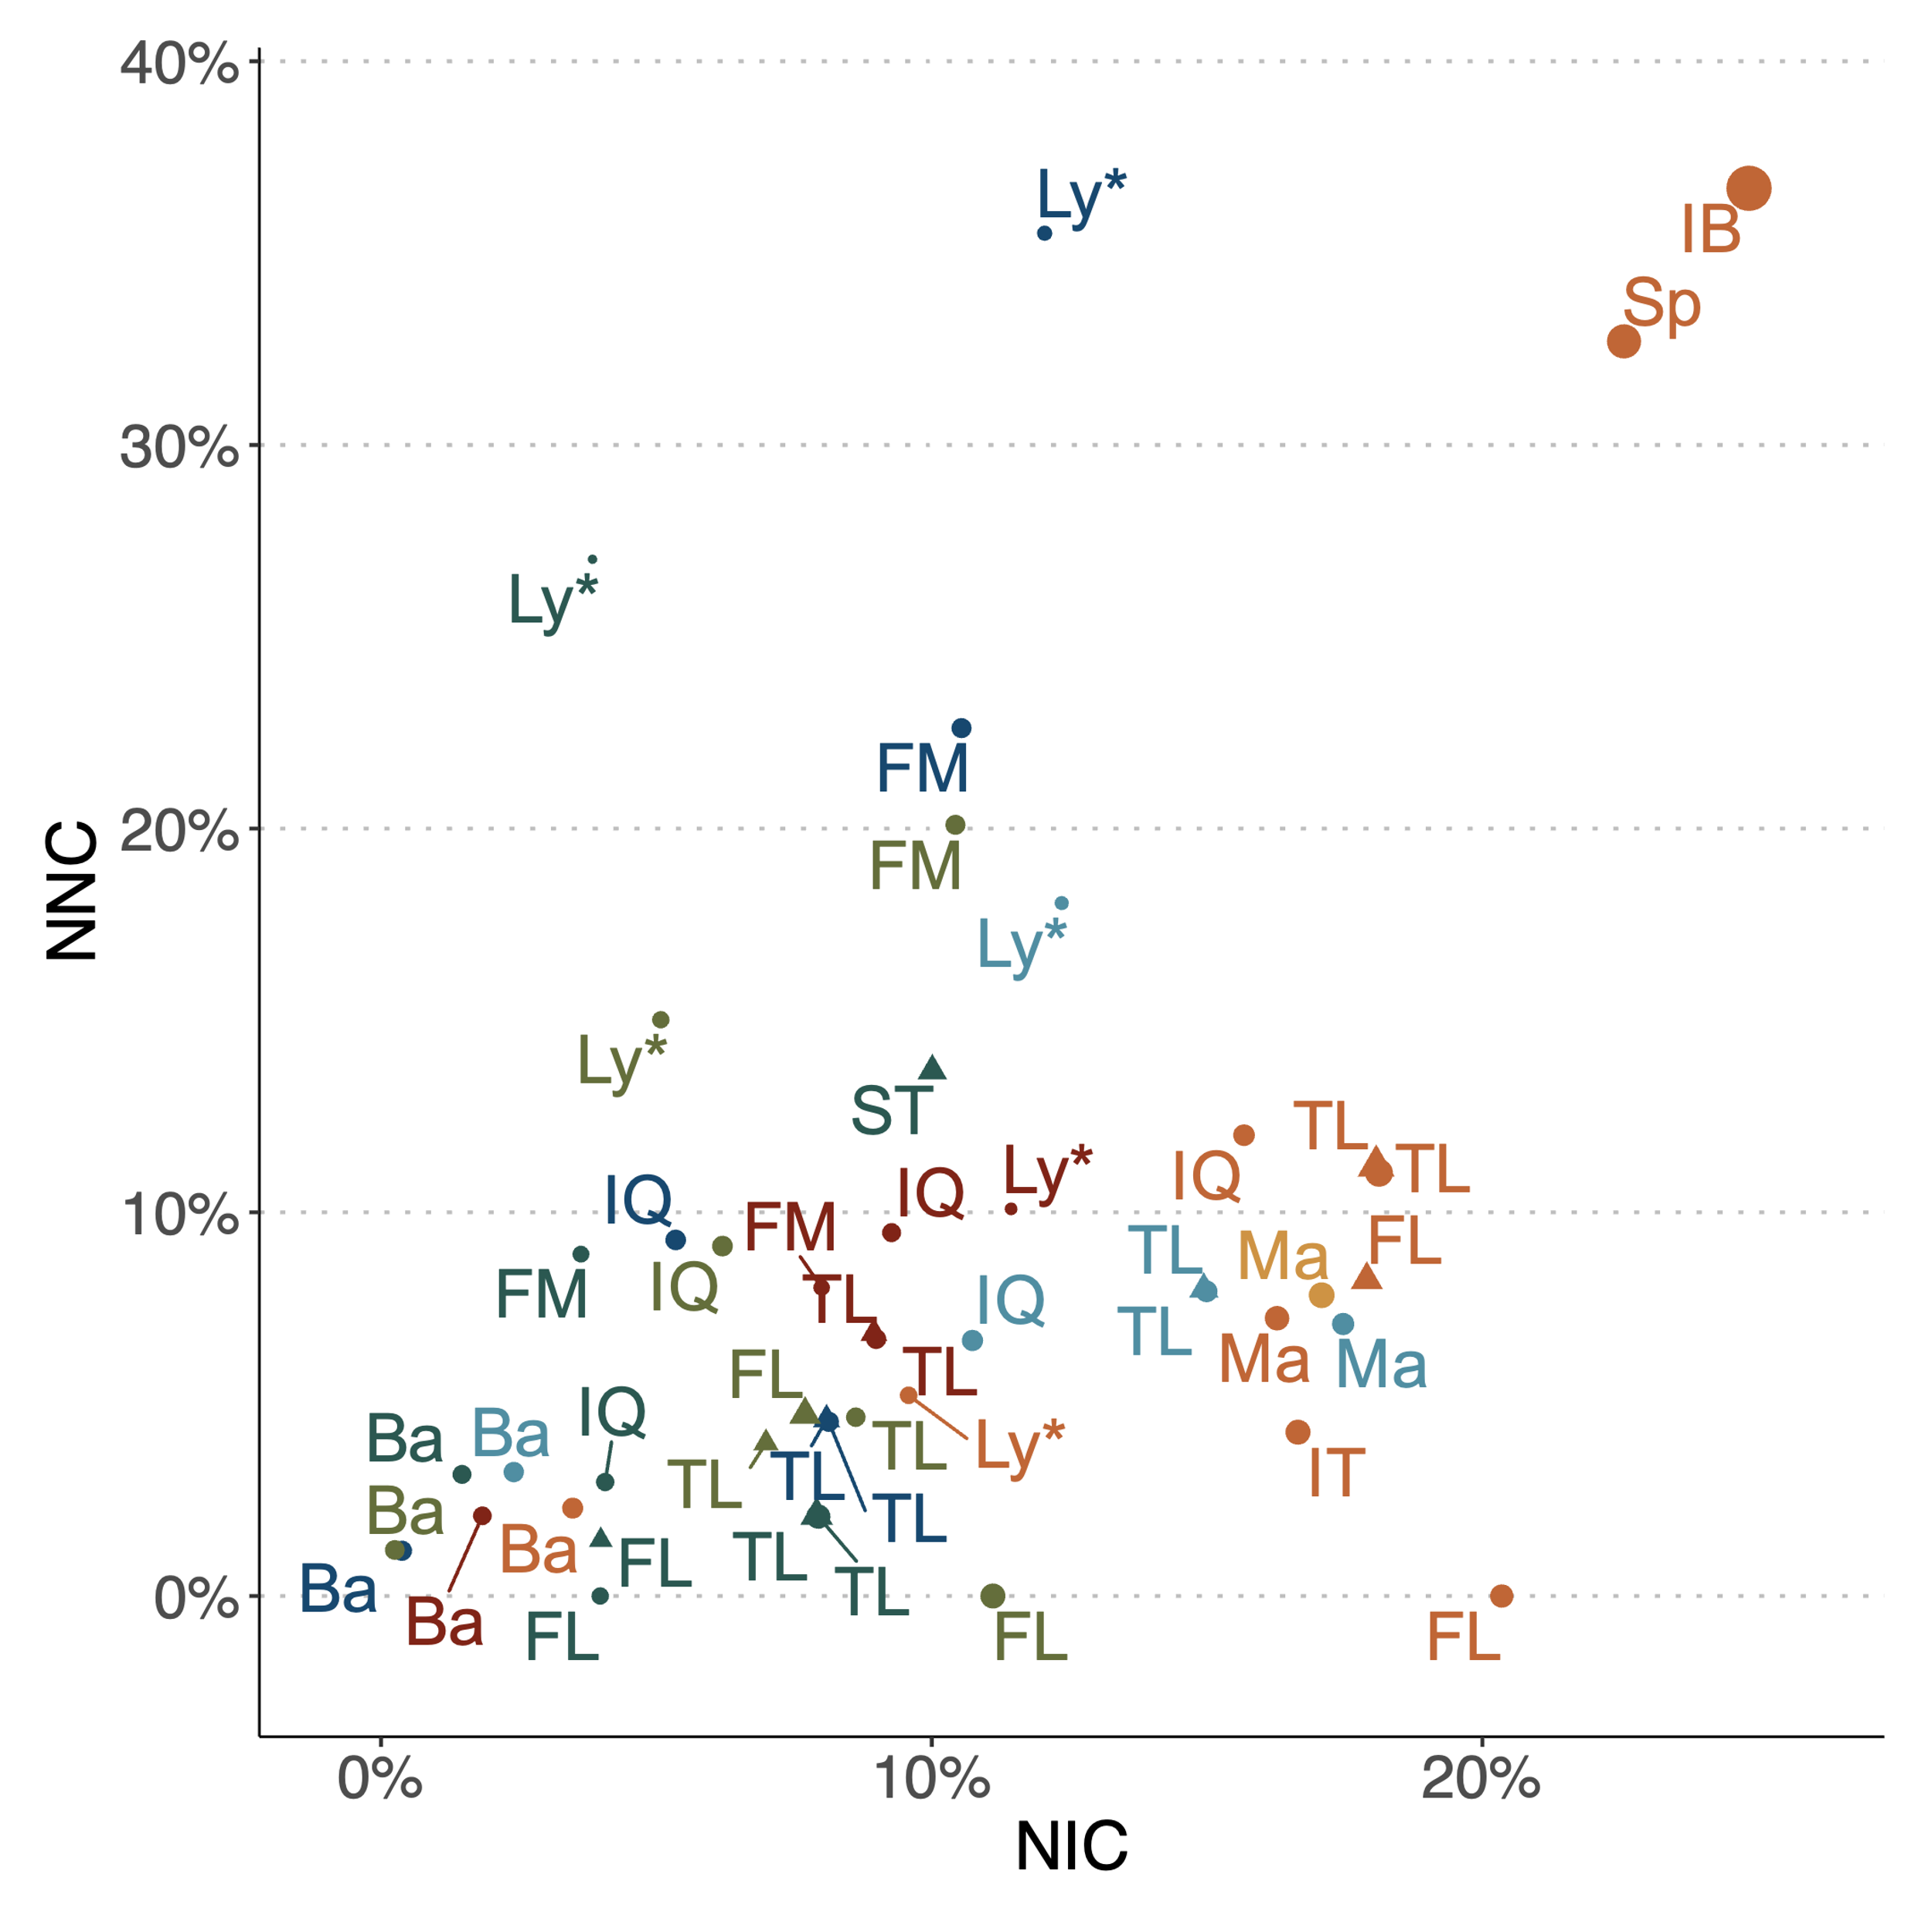
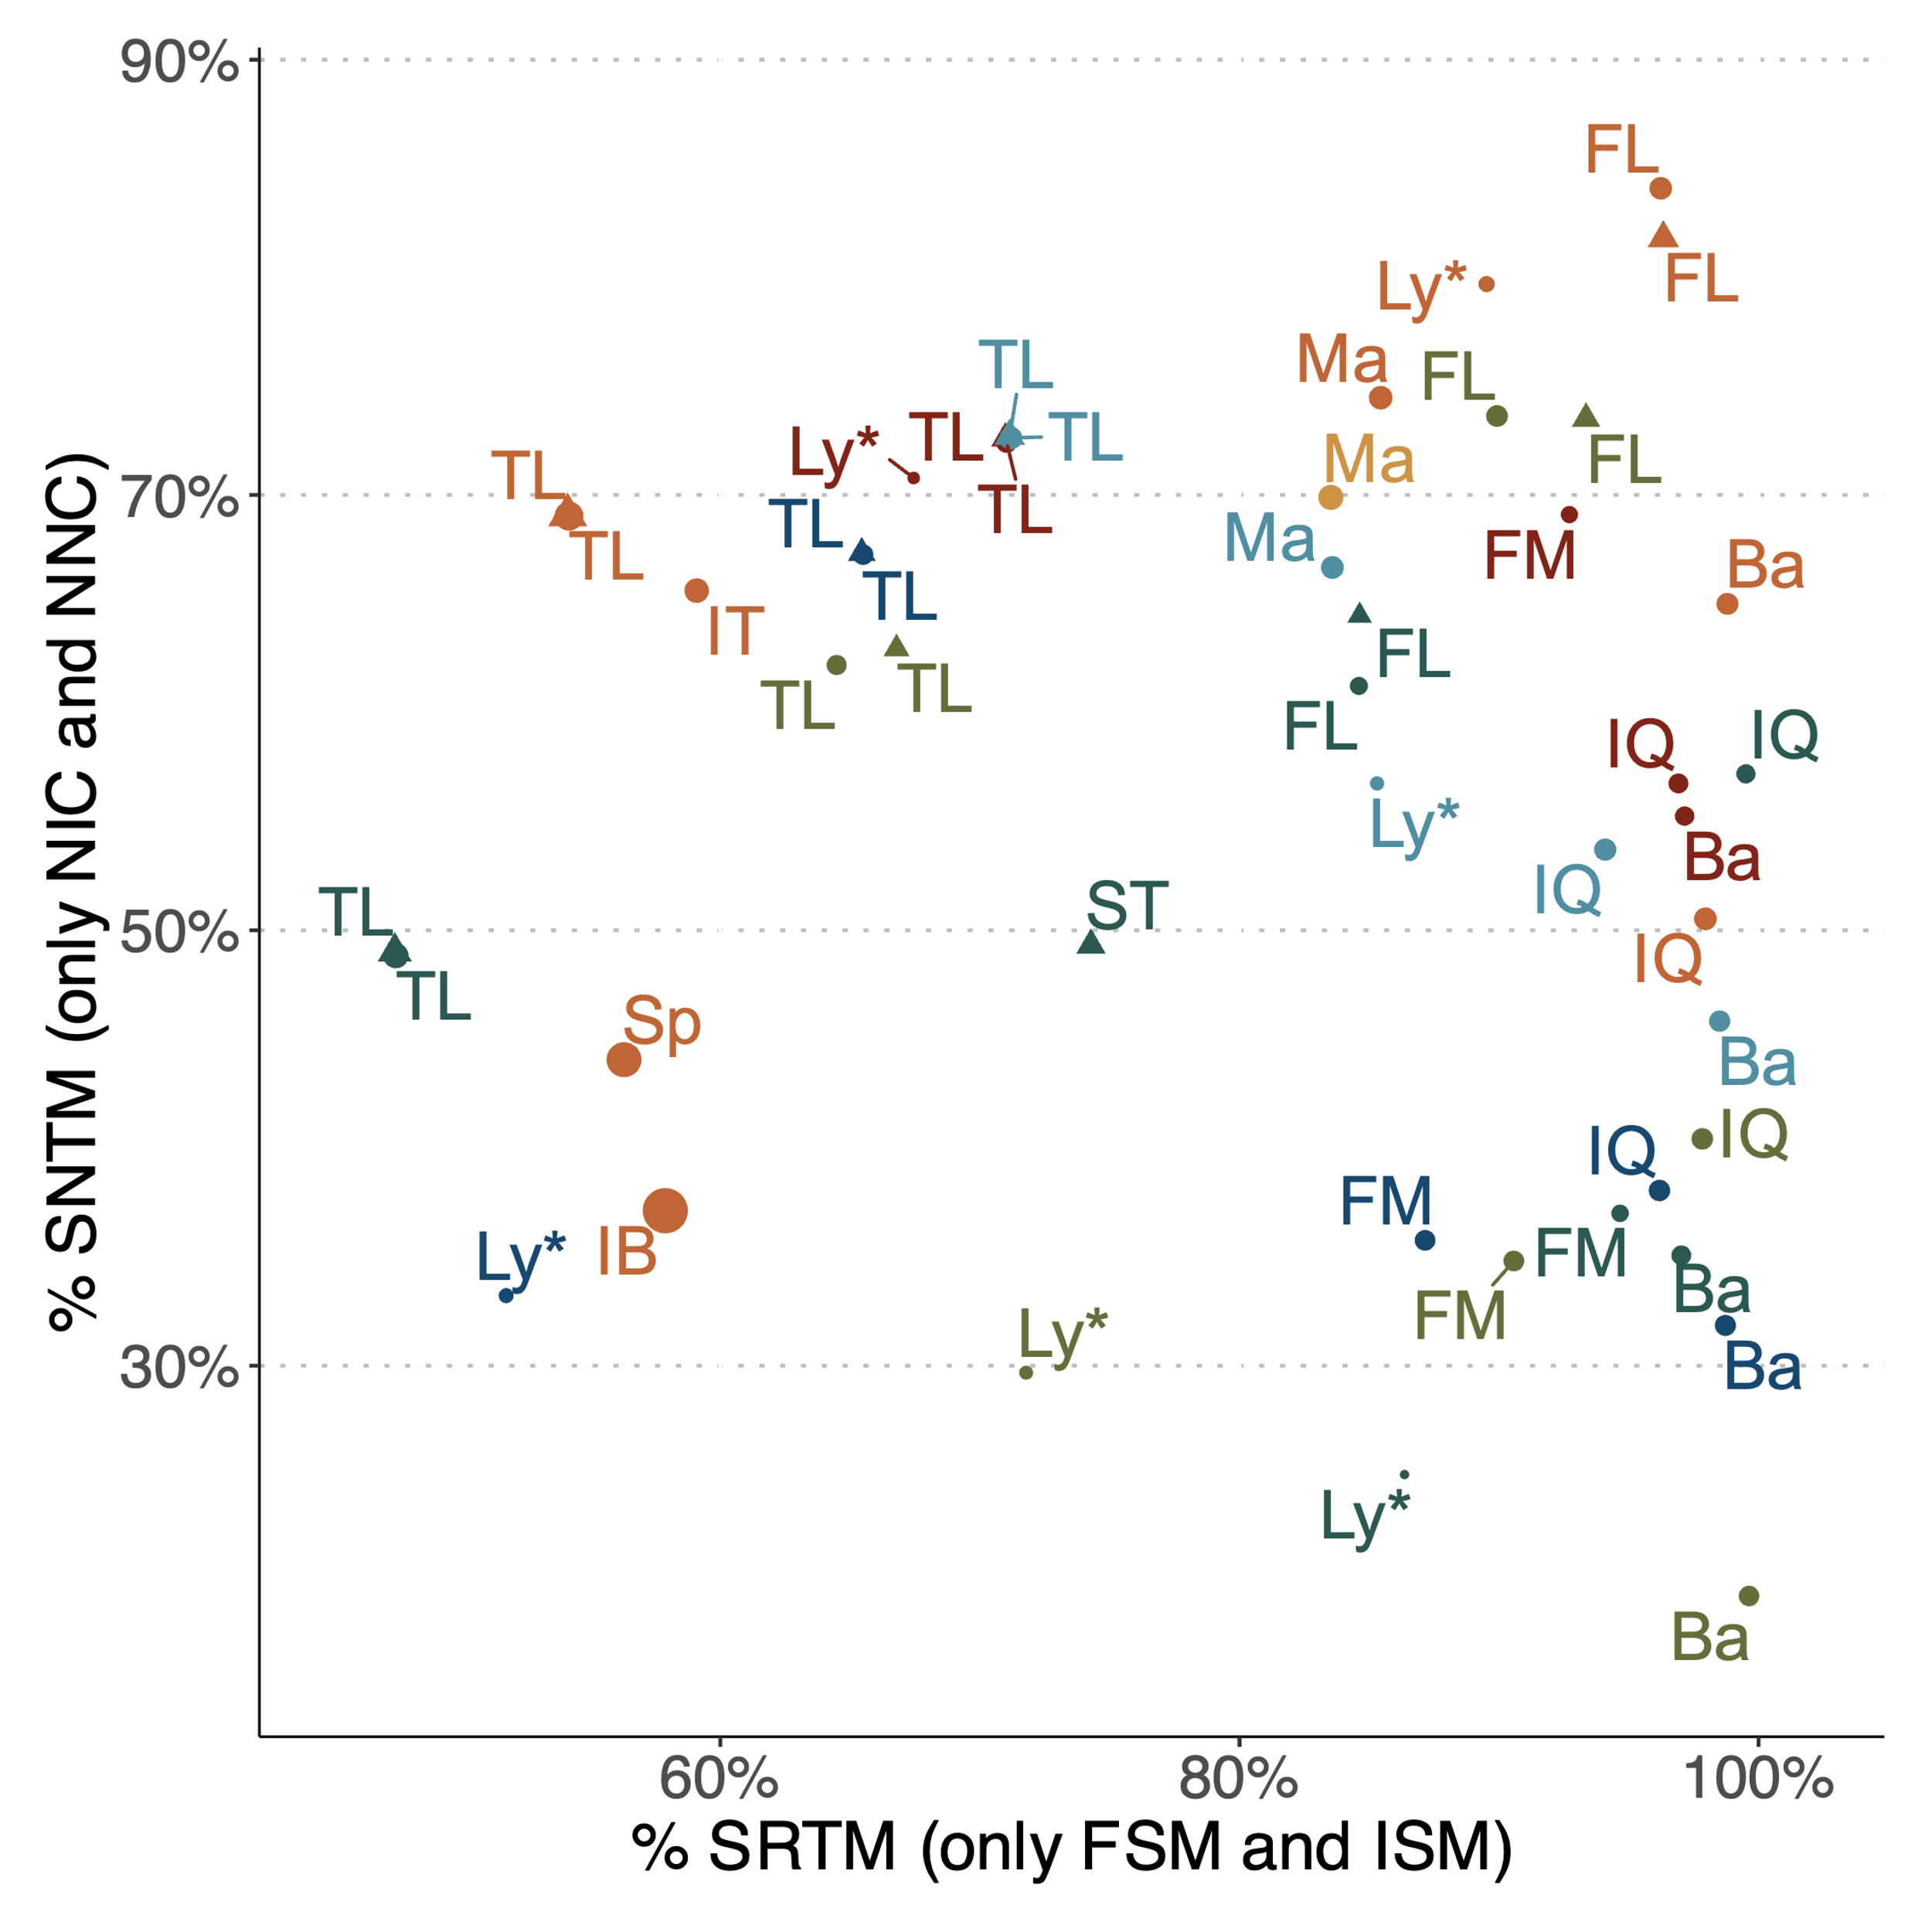
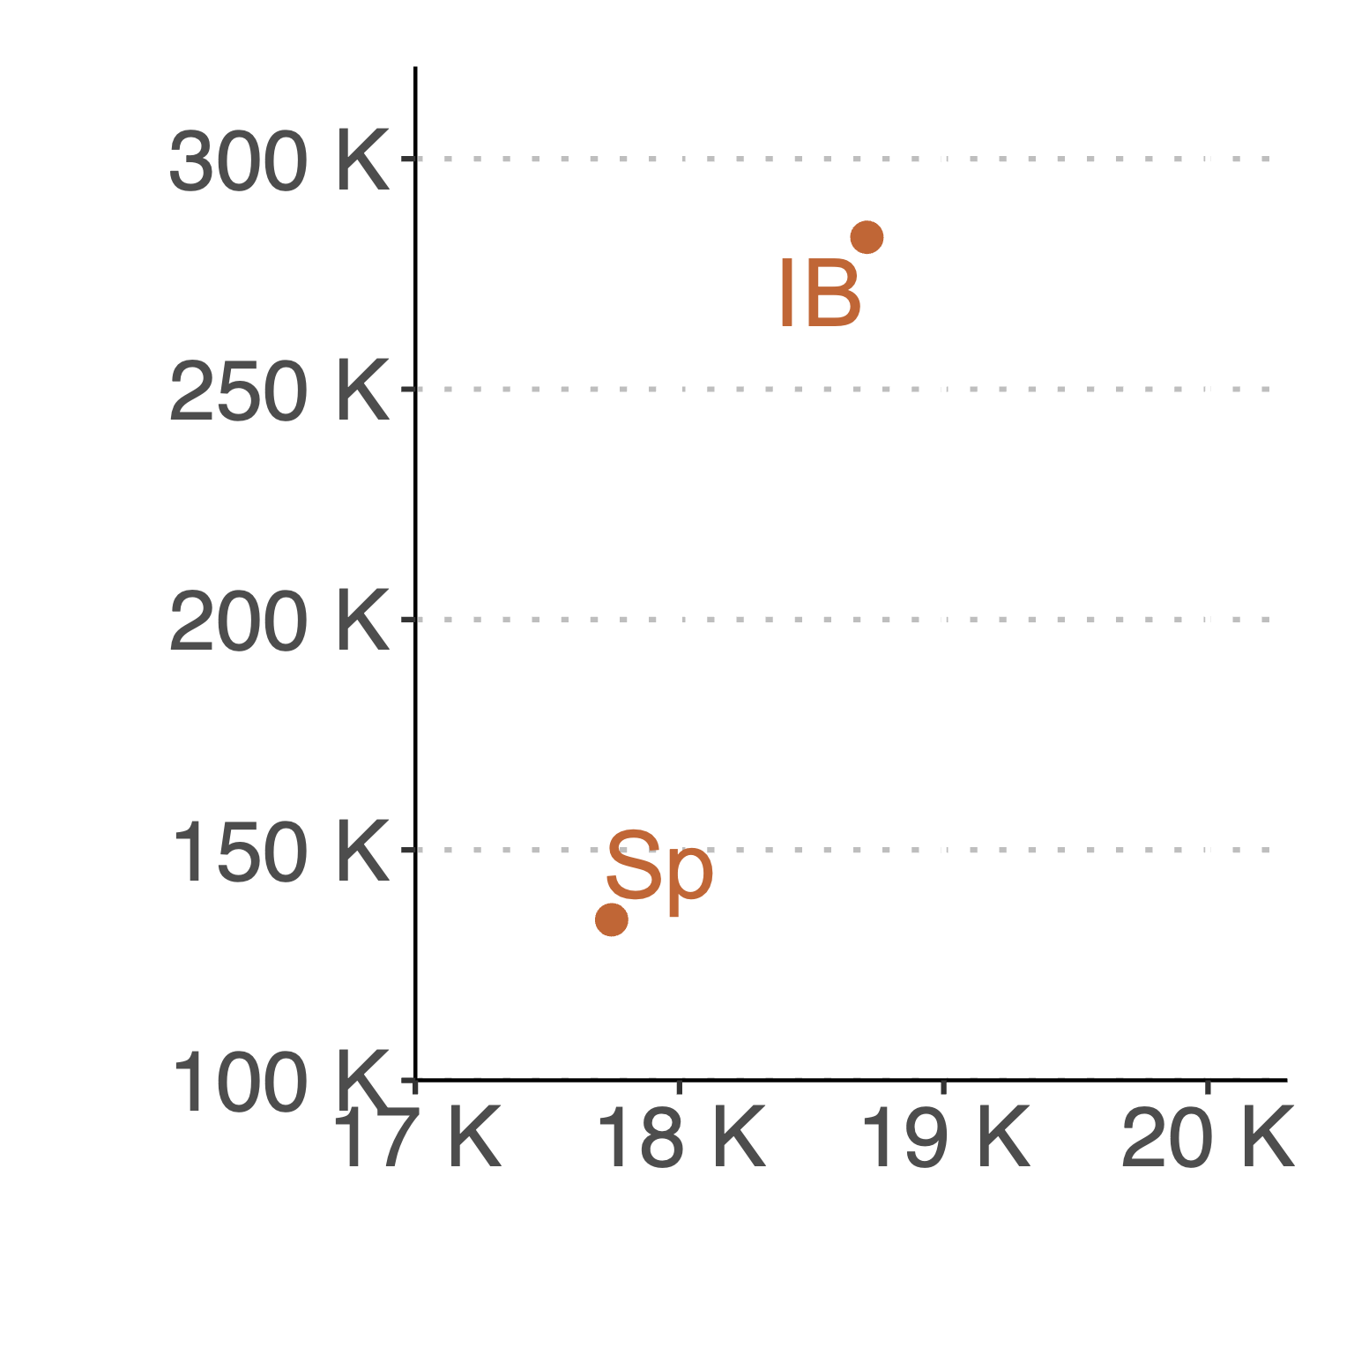
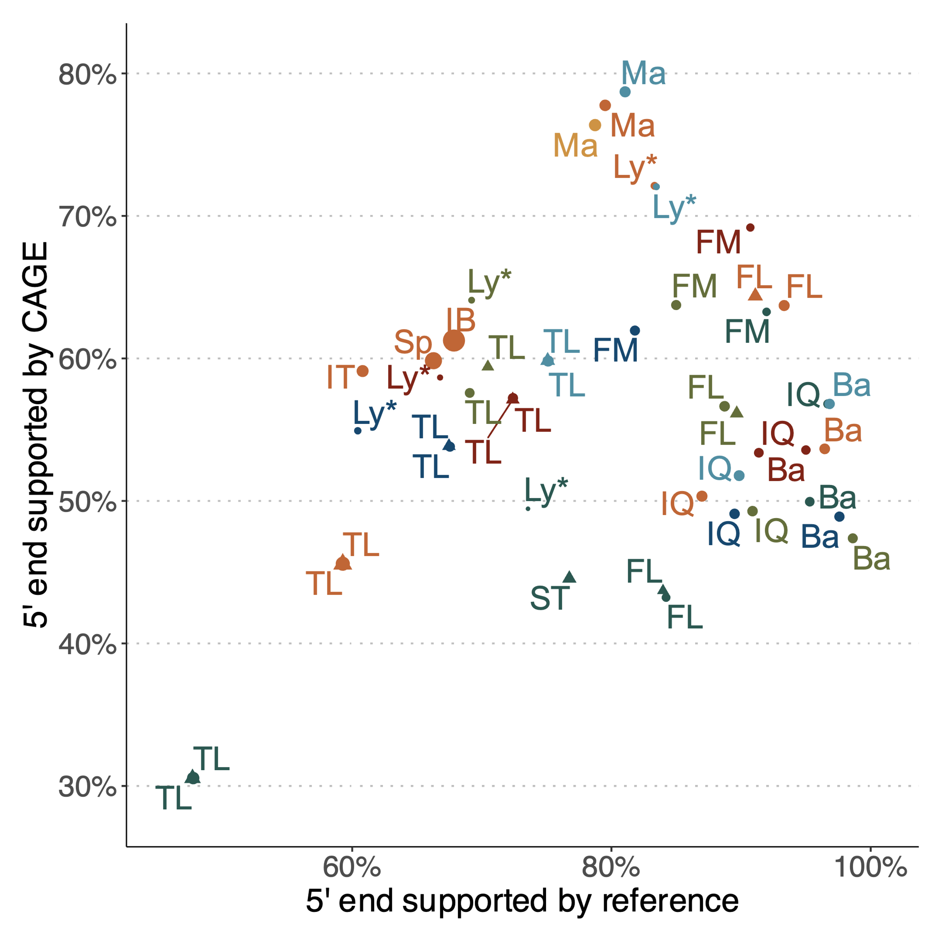
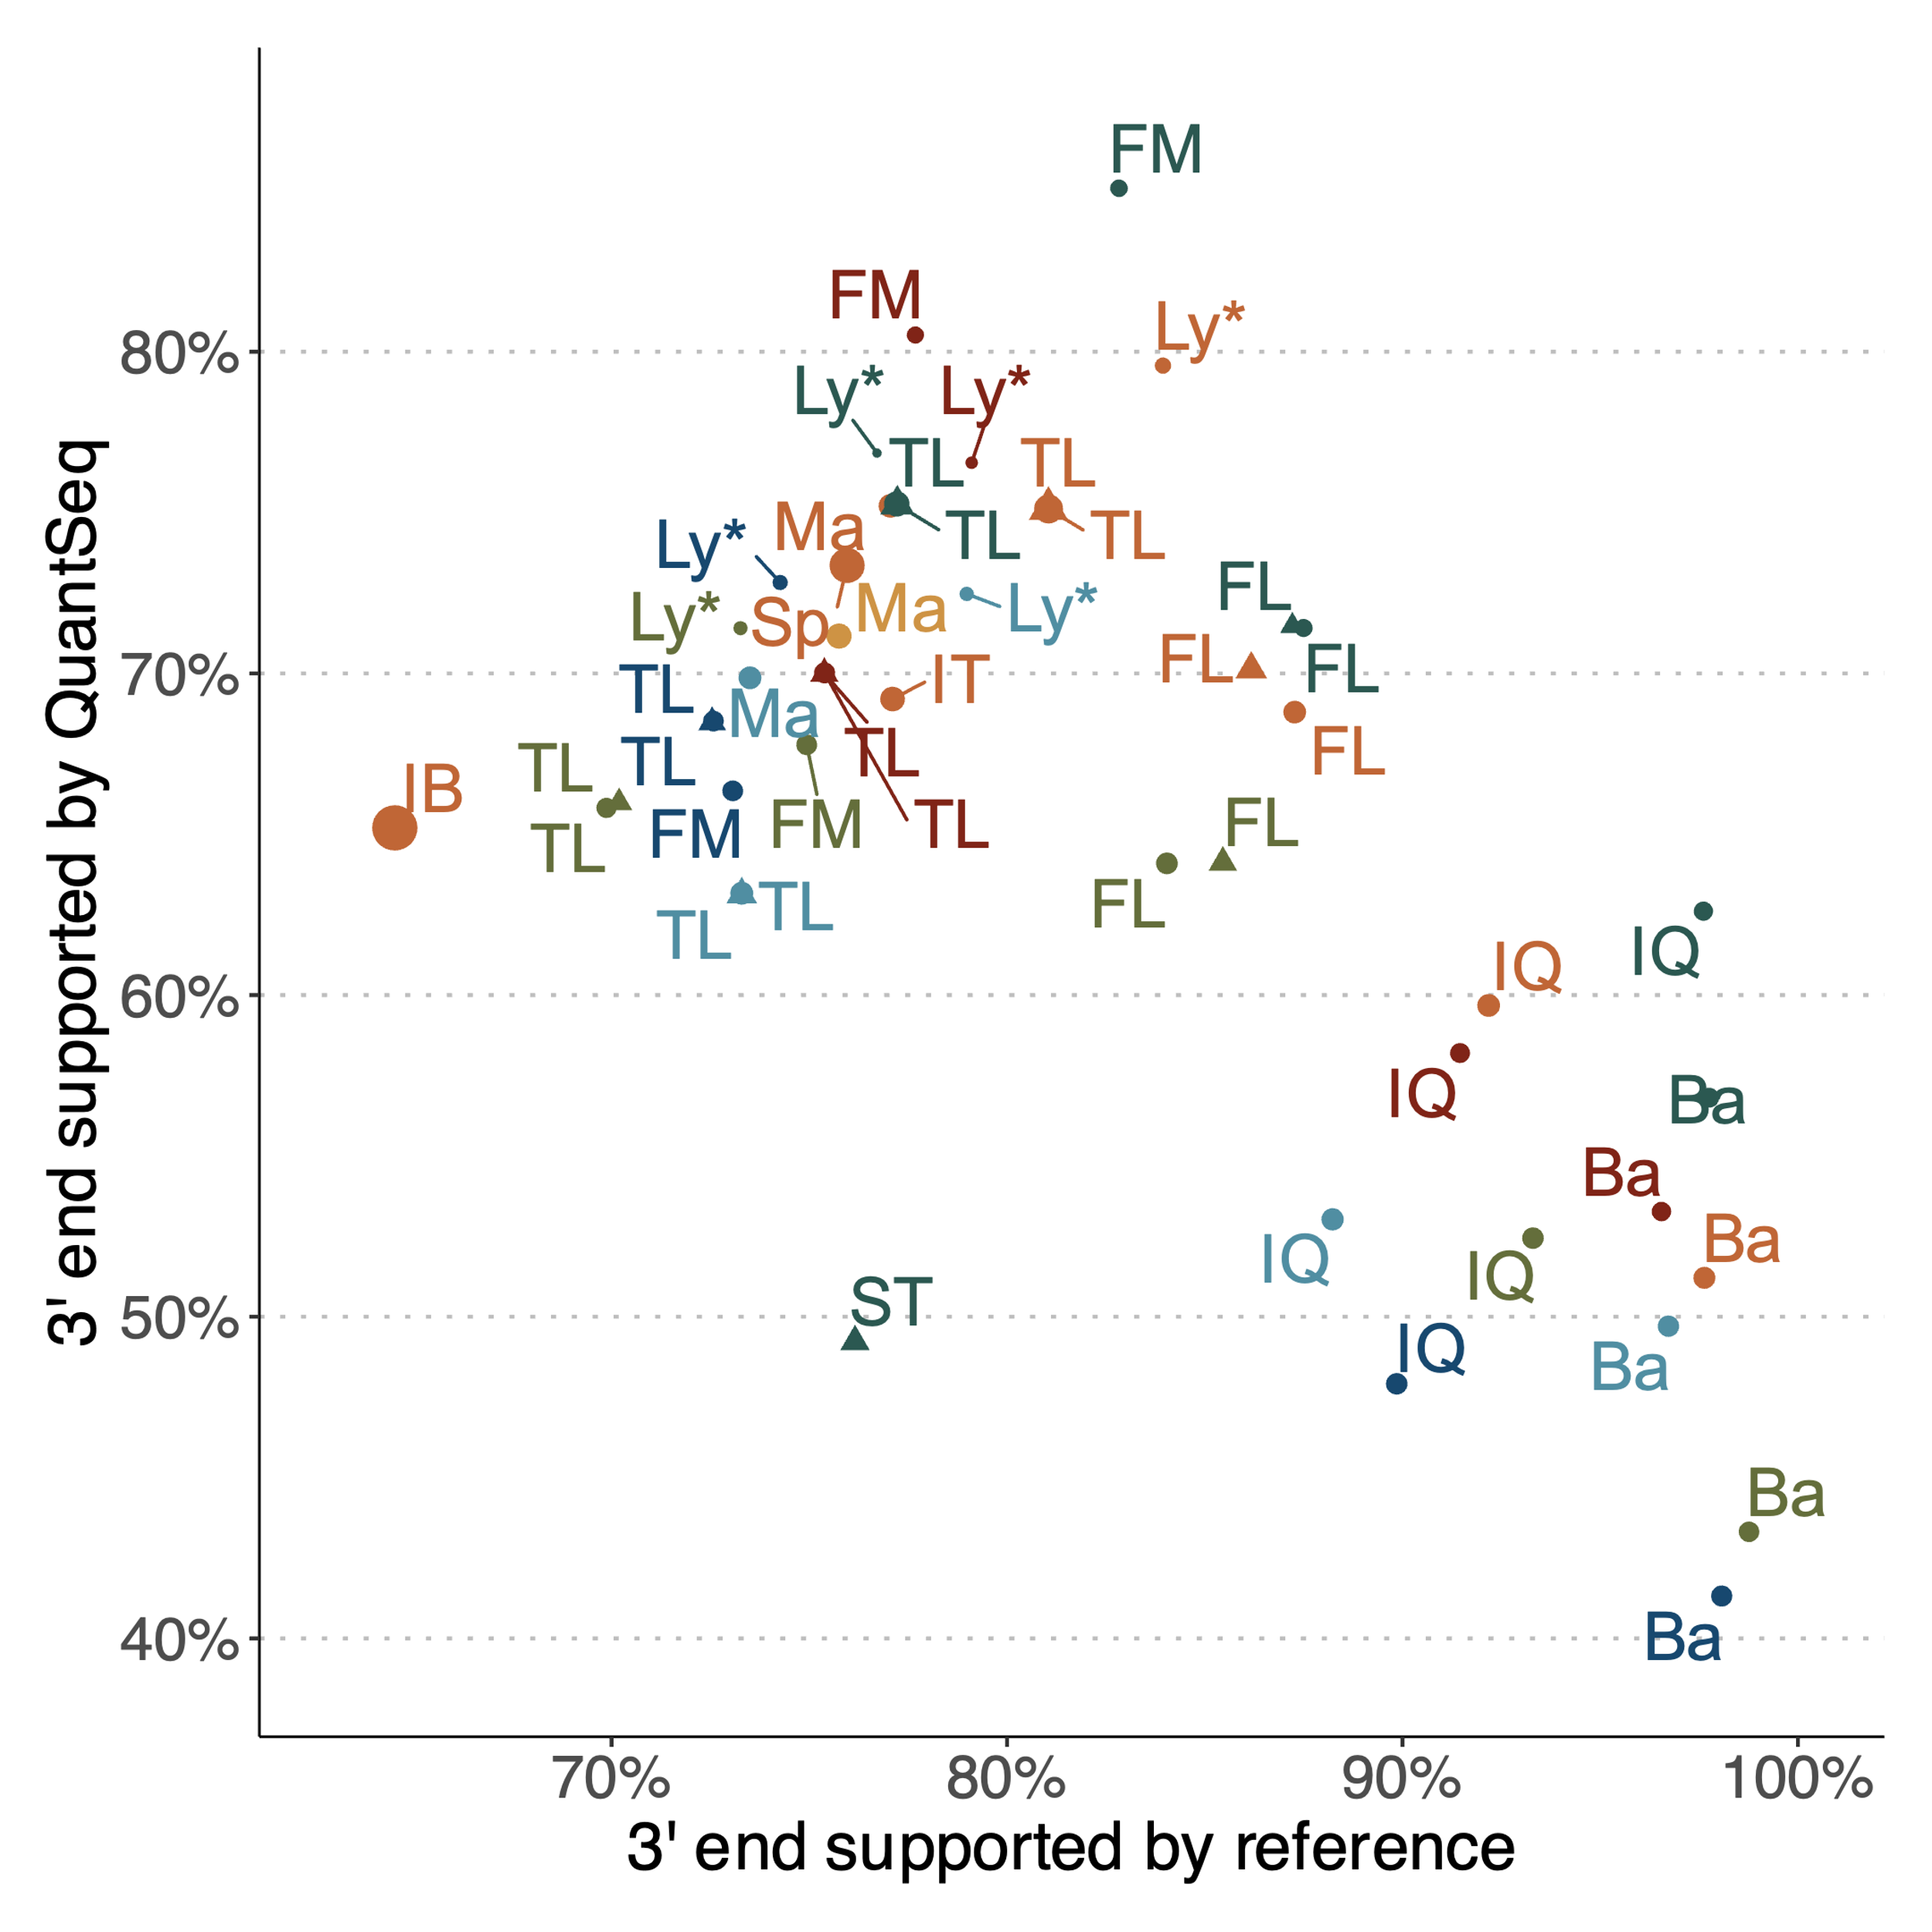
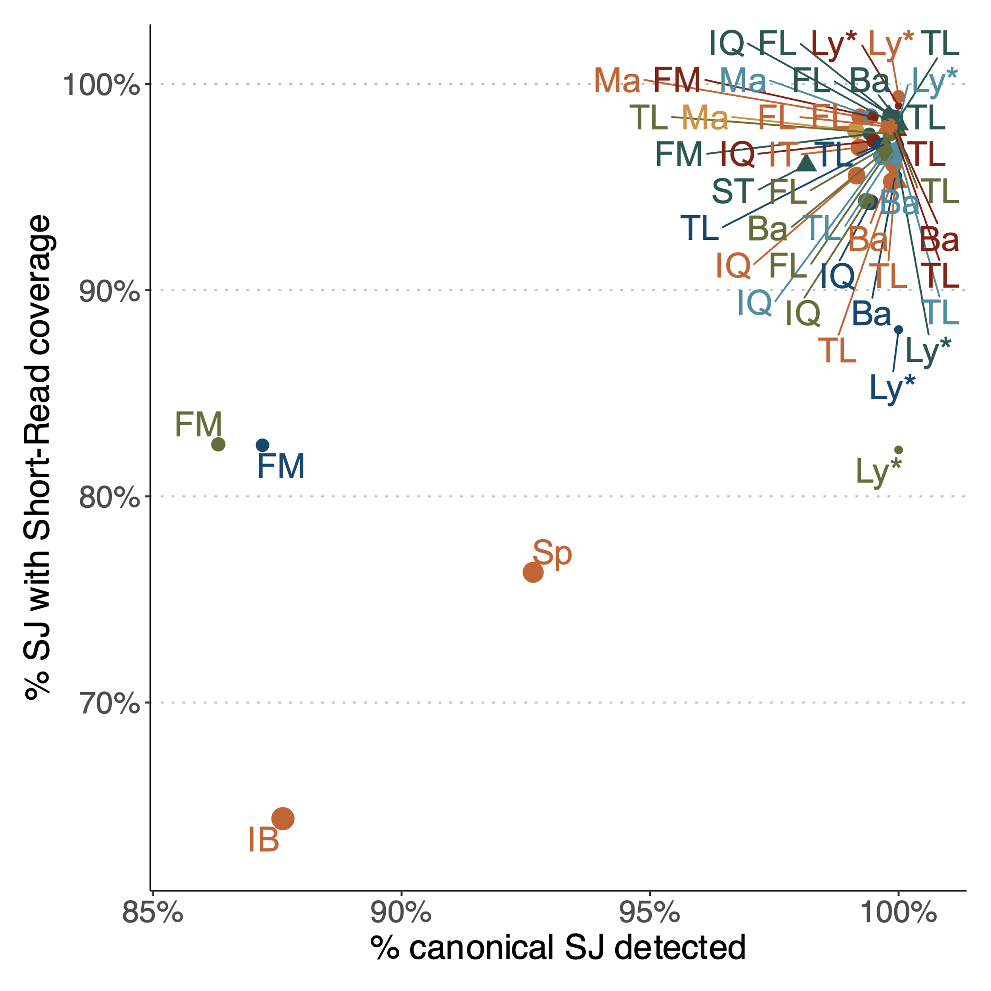
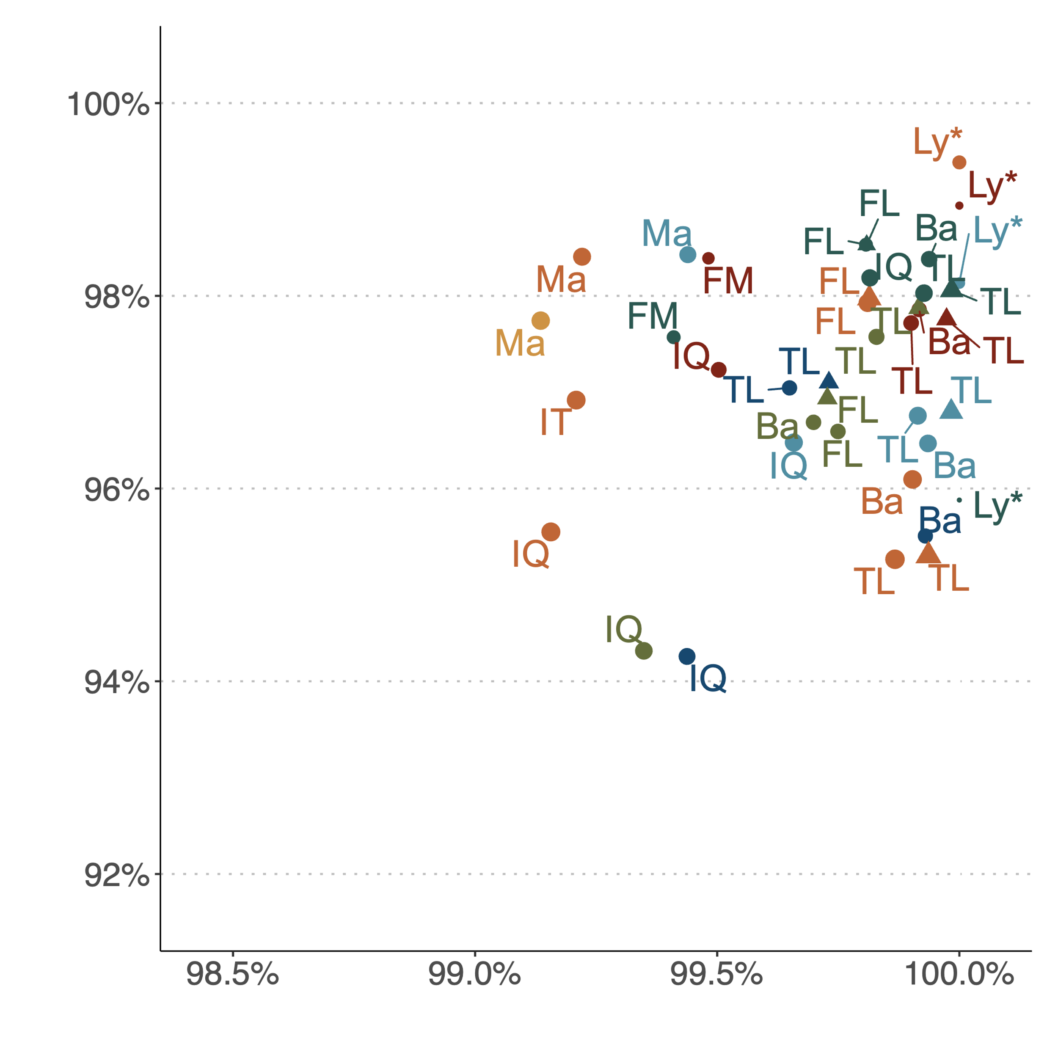
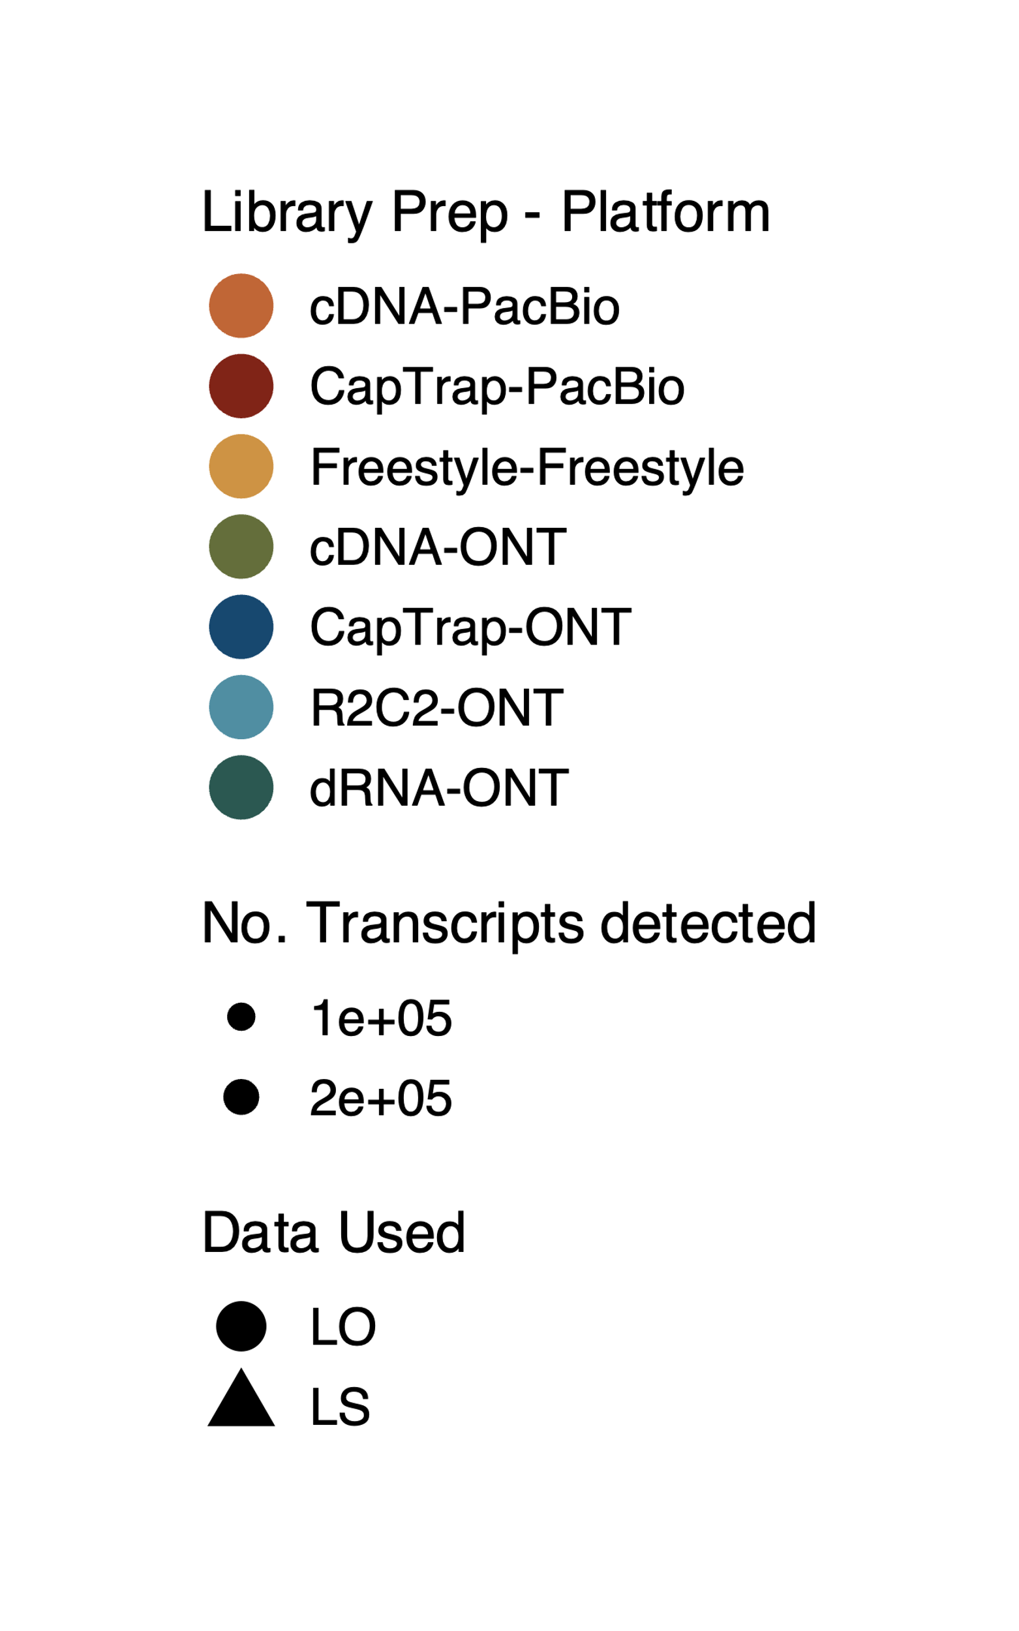
a)
b)
c)
d)
e)
f)
g)
Extended Data Fig. 3. SQANTI3 evaluation of LRGASP submissions of the mouse ES dataset. Labels correspond to analysis tools and the color code indicates the combination of library preparation and sequencing platform. a) Number of gene and transcript detections. b) Number of Full Splice Match and Incomplete Splice Match transcripts. c) Number of Novel in Catalogue and Novel Not in Catalogue transcripts. d) Number of known and novel transcripts with full support at junctions and end positions. e) Percentage of transcripts with 5´end support. f) Percentage of transcripts with 3´end support. g) Percentage of canonical splice junctions (SJ) and short-reads support at SJ. Ba: Bambu, FM: Flames, FL: FLAIR, IQ: IsoQuant, IT: IsoTools, IB: Iso_IB, Ly: LyRic, Ma: Mandalorion, TL: TALON-LAPA, Sp: Spectra, ST: StringTie2.

